Slide 1
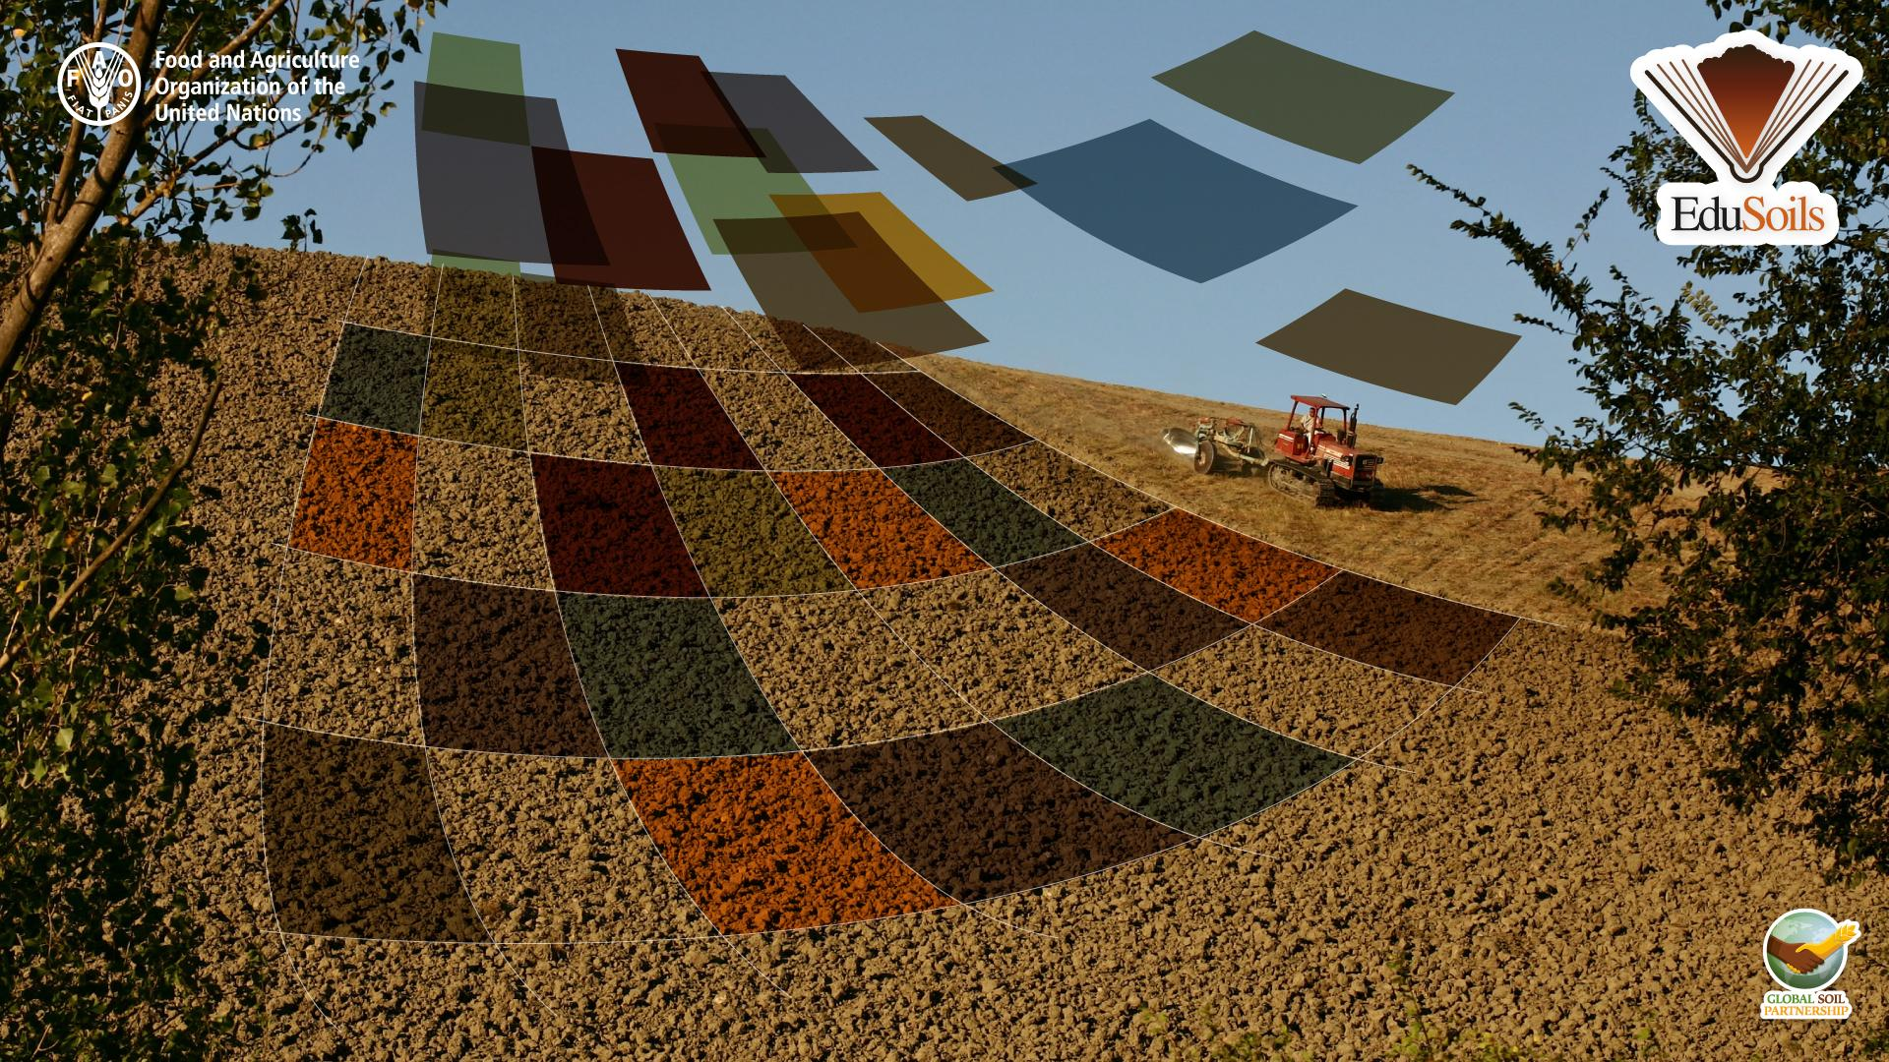


Digital Soil Mapping in R Training on National Soil Databases and Soil Property Mapping

Slide 2
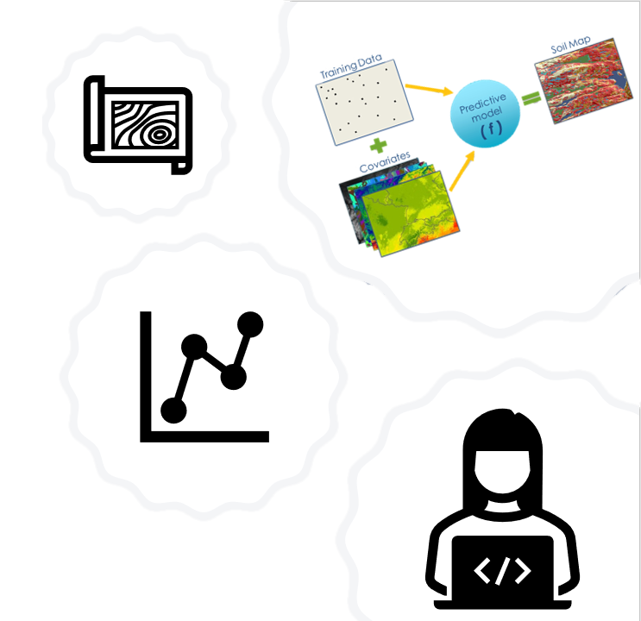

Video Content:
Main learning outcomes
Why was this course created
The Global Soil Partnership (GSP)
The Global Soil Information System (GloSIS)
Soil Information & Data: Capacity development
The Global Soil Organic Carbon Map (GSOCmap)
The Global Soil Organic Sequestration Potential Map (GSOCseq)
Target Audience
Course Content

Slide 3
Main learning outcomes:
Understand the advantages of using programming languages for spatial data analysis
Apply geostatistical and data-mining based methodologies to your own soil data
Interpolate Soil Organic Carbon (SOC) and Clay data using the R language

Slide 4

The Global Soil Partnership (GSP)
2
Was established in December 2012 with the main aim of:
creating a mechanism to foster strong partnerships and collaboration to place soils on the global agenda;
promoting Sustainable Soil Management (SSM);
improving the governance of soils.
1
1
2
3
3
Find out more about the GSP and its many activities and projects here: http://www.fao.org/global-soil-partnership/en/

Slide 5
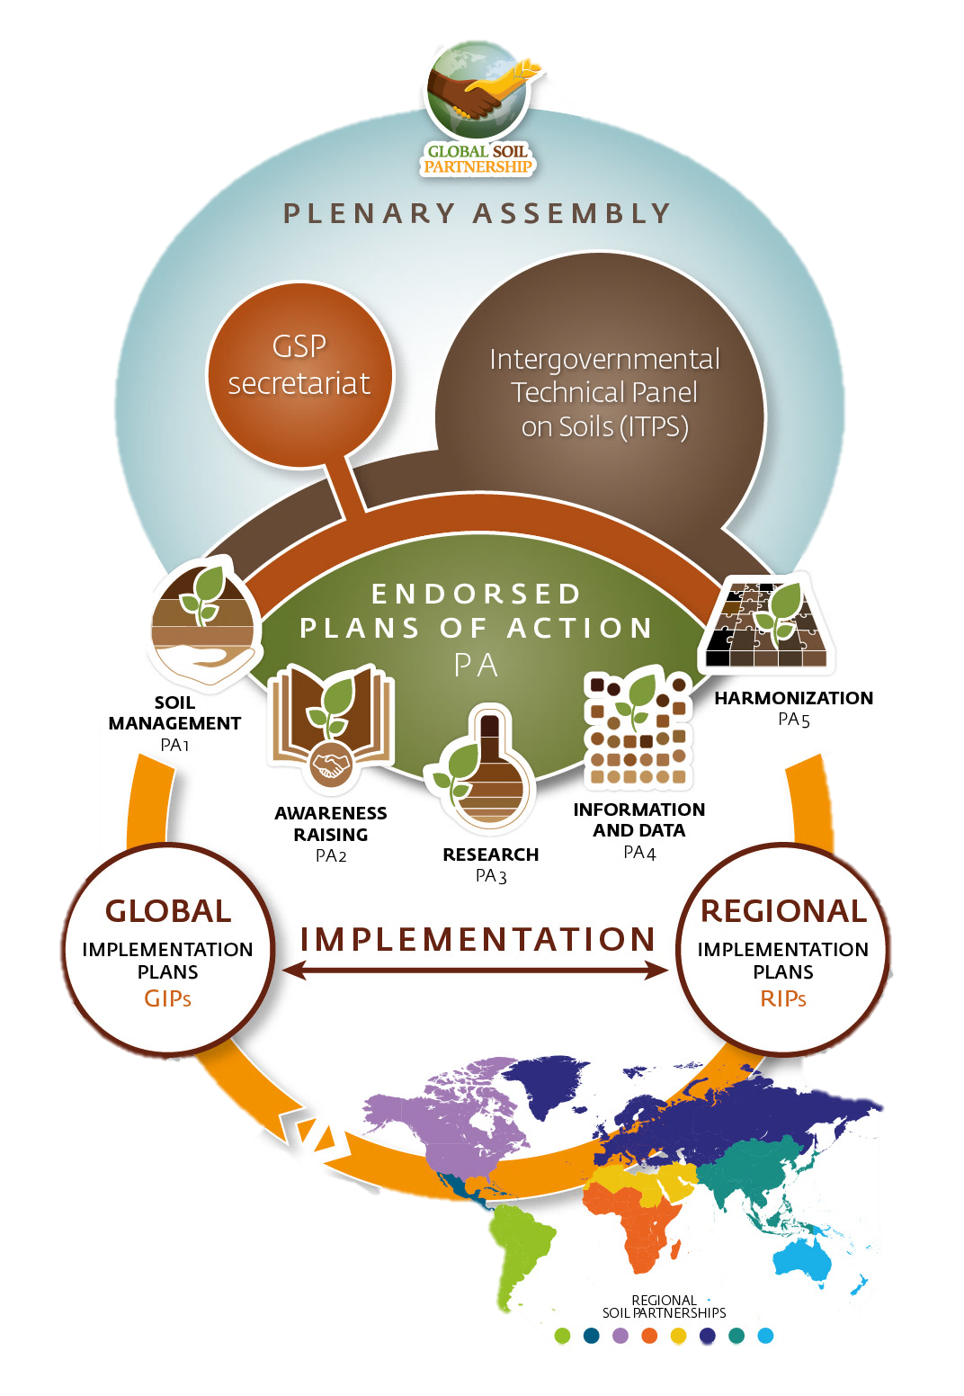
The Global Soil Partnership (GSP)
in numbers:
8 regional partnerships, over 370 partners worldwide​
160 focal points appointed directly by UN’s Food and Agriculture Organization FAO member countries​
13 expert working groups on soil organic carbon, soil pollution, soil erosion, soil biodiversity, soil salinity, soil legislation and more!

Slide 6


Soil Information and Data
Global Soil Information System (GloSIS) to:
develop and improve capacities at national level for data handling and management;
support countries in developing their own soil information systems;
enable monitoring, forecasting and status reporting of soil resources.
GloSIS is a country-driven which means:
countries maintain full control of their data
countries are supported in establishing harmonized soil information systems in a to tackle transboundary issues

Slide 8
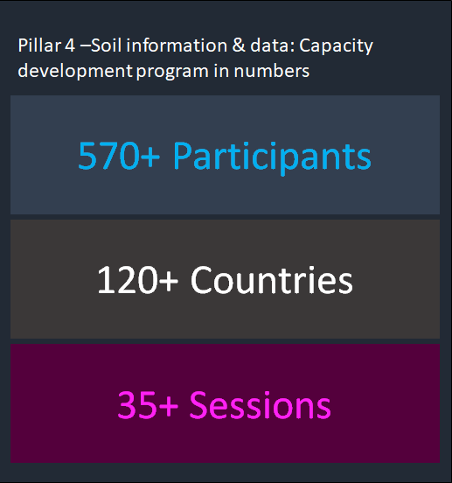
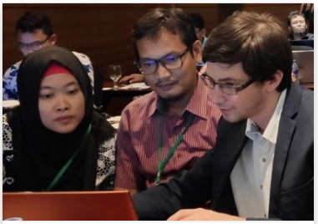
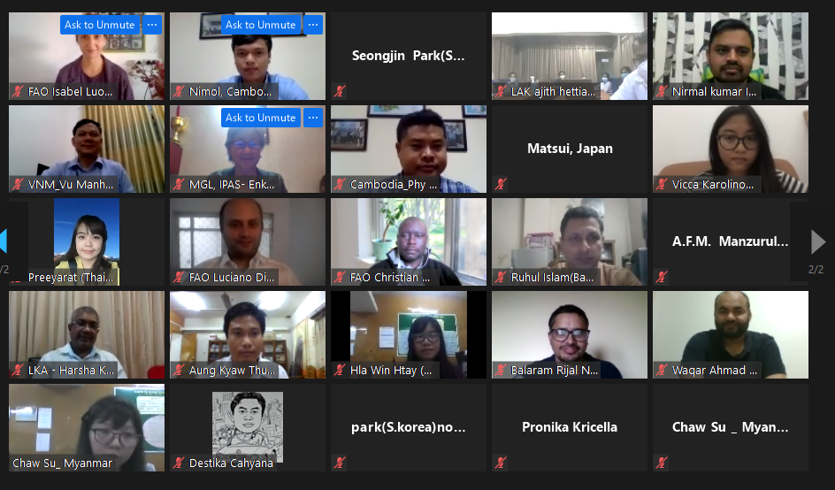
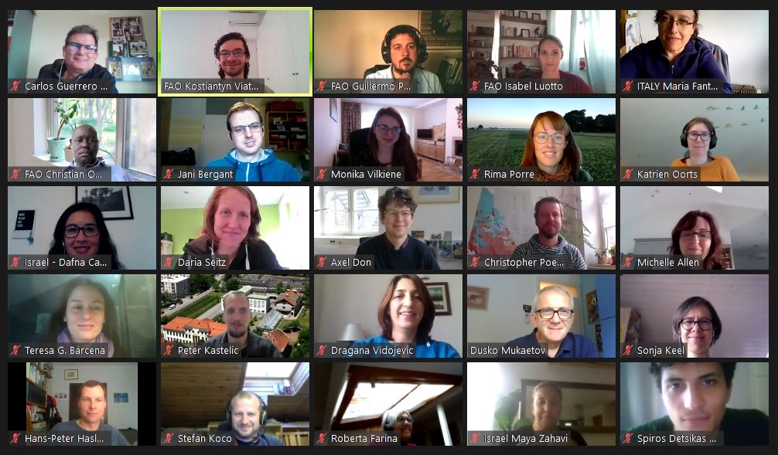
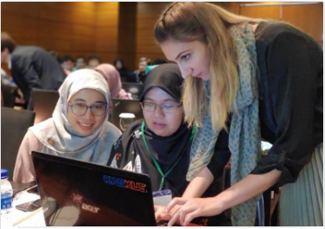
Soil Information and Data

Slide 9
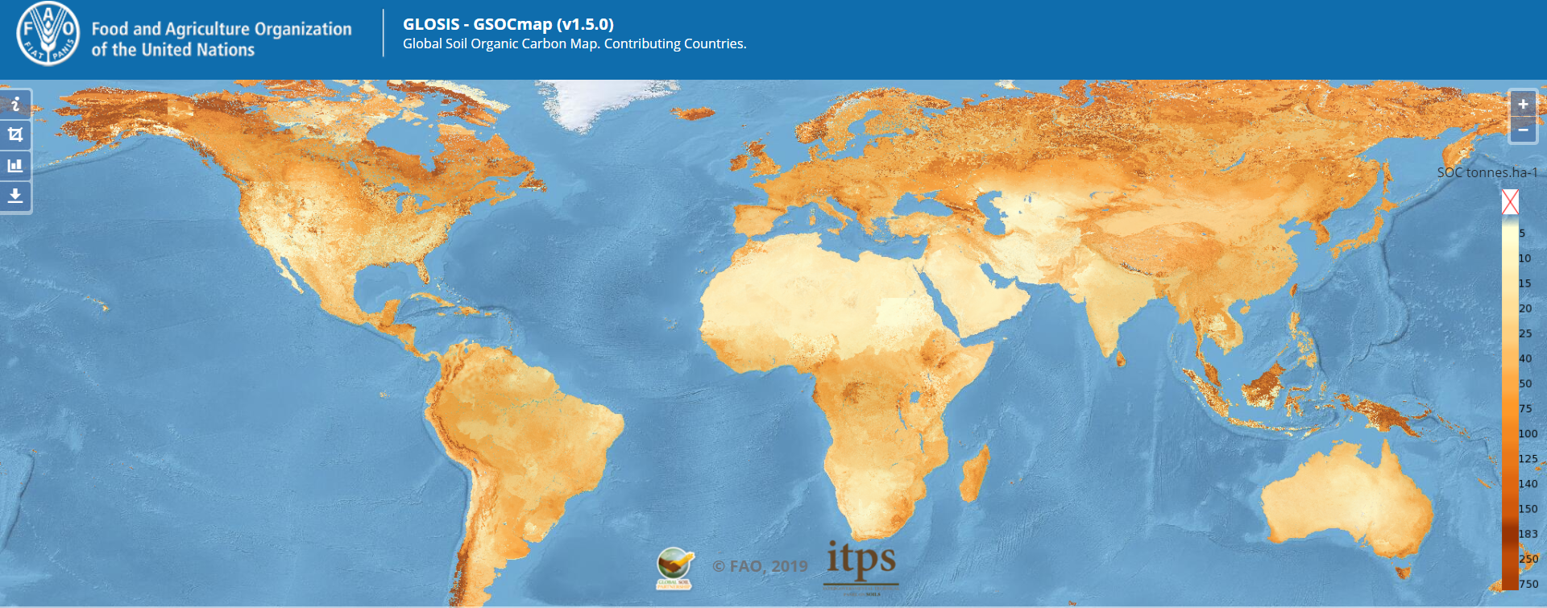
Soil Information and Data

Slide 10
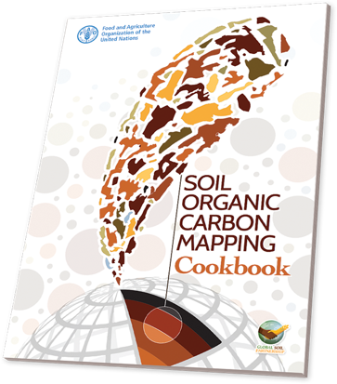
Soil Information and Data
The content in this course builds upon the material devised for the launch of the Global Soil Organic Carbon Map (GSOCmap) and the Global Soil Organic Sequestration Potential Map (GSOCseq)
GSOCmap Cookbook:https: //fao-gsp.github.io/SOC-Mapping-Cookbook/
GSOCseq Technical Manual:https: //fao-gsp.github.io/GSOCseq/

Slide 11


Target Audience of this course:
National experts mandated by the International Network on Soil Information Institutions (INSII) & GSP Partners
Researchers and Students interested in modelling and mapping soil properties at larger scales

Slide 12
Course content:
Video 1: General introduction of the course
Video 2: Introduction to the software and training data set used in this course
Video 3: Introduction to Spatial Data and Digital Soil Mapping
Video 4: Introduction to R for spatial data analysis
Video 5: Preparation of soil Data
Video 6: Preparation of the covariates
Video 7: Regression kriging
Video 8: Random forest
Video 9: Uncertainty and validation

Slide 13
